Slide 1

DAX Explained Through Dance, Memes and Dad Jokes
Barney Lawrence
@SQLBarney
github.com/BarneyLawrence/Sessions-DAX-Through-Dance

Slide 2






About Me

Slide 3
Dance

Slide 4
Dad
Daddy is funny
…but his jokes aren’t

Slide 5
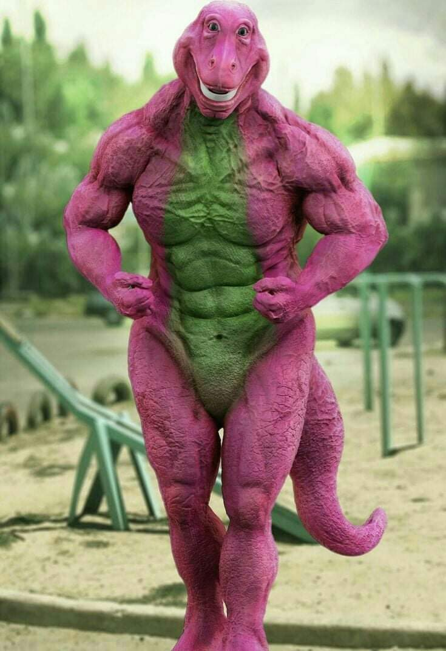
Memes

Slide 6


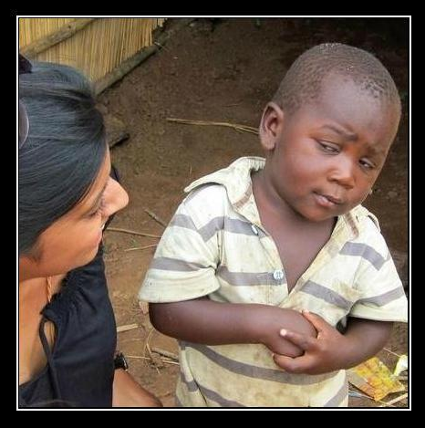

What?!
Notes:
Why an I doing this?

Slide 7

Learning DAX Stage 1

Slide 8
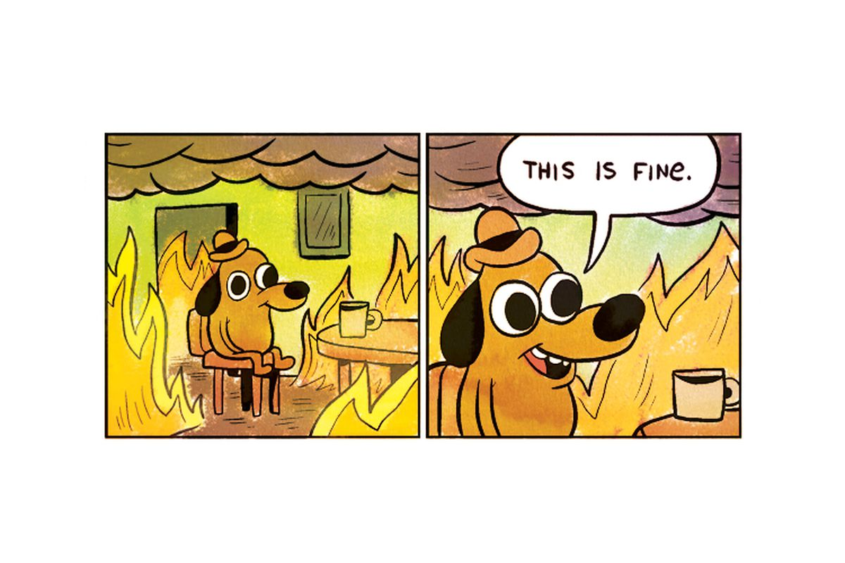
Learning Dax Stage 2

Slide 9
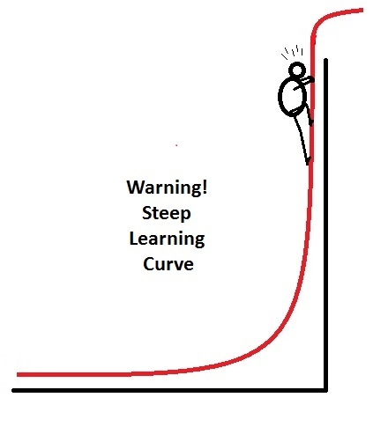
Learning Dax Stage 3

Slide 10

Shih-Tzu
Photo by Edson Torres on Unsplash

Slide 11
Key Points
Filter Context
Row Context
Calculate and Context Transition
Calculate and Context Changes

Slide 12
A Simple Calculation
Punchline Measure 1 =
VALUES(Jokes[Punchline])

Slide 13

Level 1
Punchline Measure 1 =
VALUES(Jokes[Punchline])

Slide 14

Level 2
Punchline Measure 2 =
IF(
COUNT(Jokes[Punchline]) = 1,
VALUES(Jokes[Punchline]),
"Too Many Answers"
)

Slide 15

Level 3
Punchline Measure 3 =
IF(
HASONEVALUE(Jokes[Punchline]),
VALUES(Jokes[Punchline]),
"Too Many Answers"
)

Slide 16

Level 4
Punchline Measure 4 =
SELECTEDVALUE(
Jokes[Punchline],
"Too Many Answers"
)

Slide 17

Level 5
Punchline Measure 5 =
CONCATENATEX(
Jokes,
Jokes[Punchline],
", "
)

Slide 18

Filter Context

Slide 19
Example 1
Couple | Value 1 | Value 2
Couple 1 | 2 | 1
Couple 2 | 2 | 1
Couple 3 | 2 | 1
SUM(Value1 x Value2)
=Error

Slide 20
Example 1
Couple | Value 1 | Value 2
Couple 1 | 2 | 1
Couple 2 | 2 | 1
Couple 3 | 2 | 1
SUM(Value1) x SUM(Value2)
=(2 + 2 + 2) x (1 + 1 + 1)
=18

Slide 21
Introducing SUMX
SUMX (Table, Expression)
SUMX(
Dancers,
Dancers[Value 1]*Dancers[Value 2]
)

Slide 22
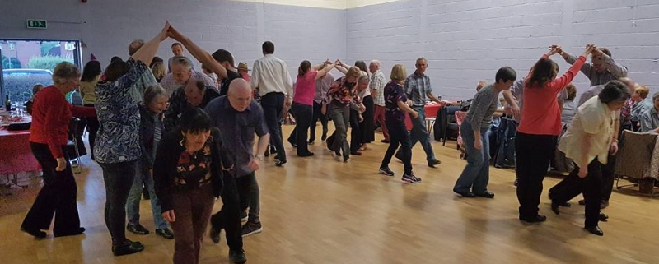
Row Context

Slide 23


Dance 1

Slide 24
Dance 1
= (2 x 1)

Slide 25
Dance 1
= (2 x 1)
+ (2 x 1)
+ (2 x 1)
=6

Slide 26
Example 2
Measure 2 = SUMX(
Dancers,
SUM(Dancers[Value 1])*SUM(Dancers[Value 2])
)

Slide 27
Guess The Result
6 (2x1 + 2x1 + 2x1)
18 (2+2+2) x (1+1+1)
Something Else

Slide 28
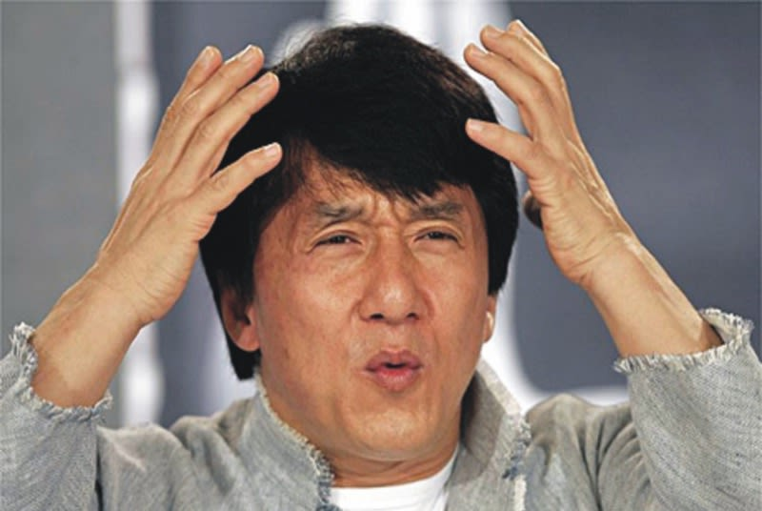
The Answer
54
6
18

Slide 29


An Explanation

Slide 30
(2+2+2) x (1+1+1)
Row 1
=18
=0
Value 1 - Value 2

Slide 31
(2+2+2) x (1+1+1)
+(2+2+2) x (1+1+1)
Row 1
Row 2
=36
=18
Value 1 - Value 2

Slide 32
(2+2+2) x (1+1+1)
+(2+2+2) x (1+1+1)
+(2+2+2) x (1+1+1)
Row 1
Row 2
=54
=36
Row 3
Value 1 - Value 2

Slide 33


Slide 34
Example 2 - Fixed
Measure 2 = SUMX(
Dancers,
CALCULATE(
SUM(Dancers[Value 1])*SUM(Dancers[Value 2])
)
)

Slide 35
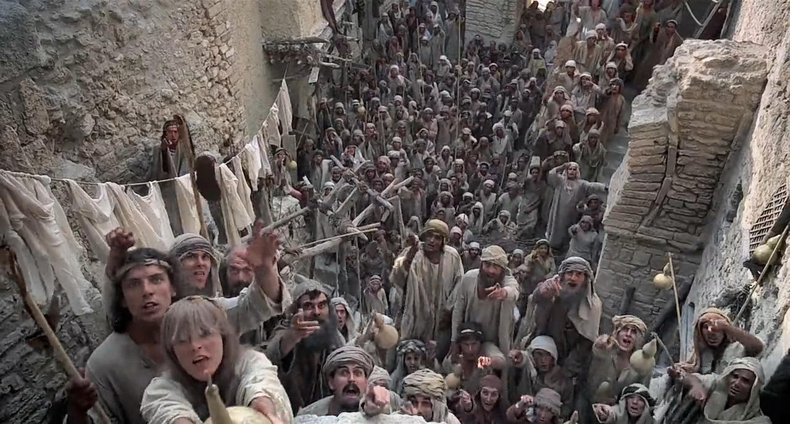
We’re all different!
I’m Not!

Slide 36
Example 2 – Part 2
Couple | Value 1 | Value 2
Olivia | 2 | 1
Olivia | 2 | 1
Amelia | 2 | 1

Slide 37

(2+2) x (1+1)
Value 1 - Value 2

Slide 38



(2+2) x (1+1)
+(2) x (1)
=8
Value 1 - Value 2

Slide 39
(2+2) x (1+1)
+(2) x (1)
+(2+2) x (1+1)
=10
=18
Value 1 - Value 2

Slide 40
Calculate
CALCULATE ( <Expression> [, <Filter> [, <Filter> [, … ] ] ] )

Slide 41
Calculate Example
Total Sales = SUM('Sales By Year'[Sales])
Red Sales =
CALCULATE(
SUM('Sales By Year'[Sales]),
'Sales By Year'[Colour] = "Red"
)

Slide 42

Original Filter Context
Calculate
New Filter Expression

Slide 43
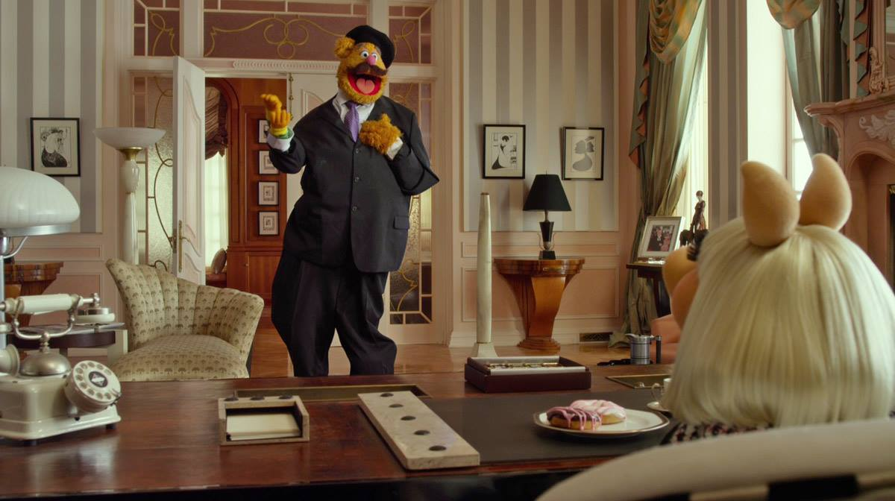
'Sales By Year'[Colour] = "Red"

Slide 44
Calculate Expanded
Red Sales =
CALCULATE(
SUM('Sales By Year'[Sales]),
FILTER(
ALL('Sales By Year'[Colour]),
'Sales By Year'[Colour] = "Red"
)
Red Sales =
CALCULATE(
SUM('Sales By Year'[Sales]),
'Sales By Year'[Colour] = "Red"
)

Slide 45
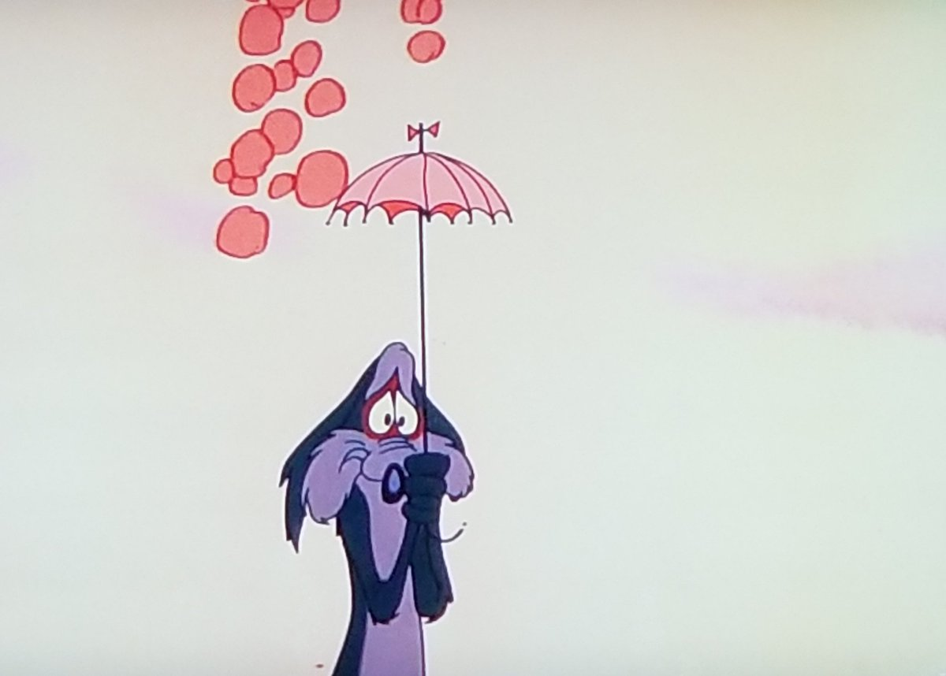
ALL

Slide 46
Original Filter Context
Calculate
New Filter Expression

Slide 47
Values
Red Sales 2 =
CALCULATE(
SUM('Sales By Year'[Sales]),
FILTER(
VALUES('Sales By Year'[Colour]),
'Sales By Year'[Colour] = "Red"
)
)

Slide 48
Keep Filters
Red Sales 3 =
CALCULATE(
SUM('Sales By Year'[Sales]),
KEEPFILTERS('Sales By Year'[Colour] = "Red")
)

Slide 49
Key Points
Filter Context
Row Context
Calculate and Context Transition
Calculate and Context Changes

Slide 50
DAX Explained Through Dance, Memes and Dad Jokes
Barney Lawrence
@SQLBarney
github.com/BarneyLawrence/Sessions-DAX-Through-Dance

Slide 51

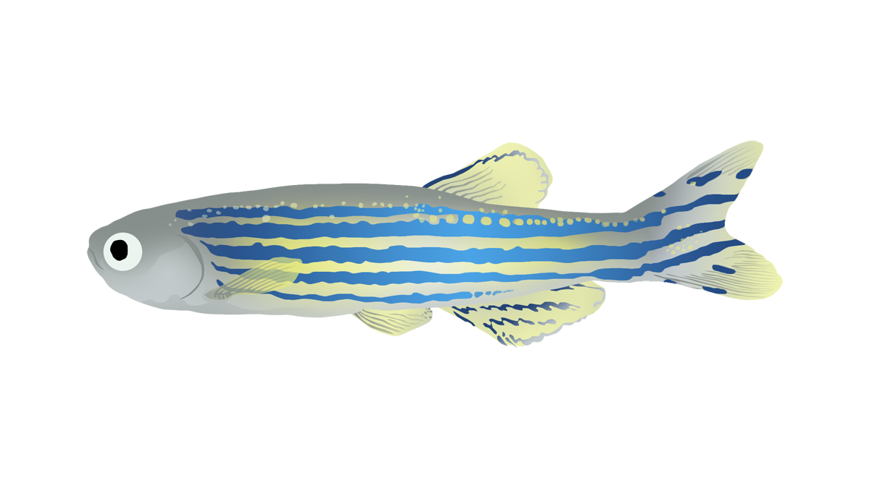

Key Influencers

